Slide 1
The GlucoWatch@ biographer: a frequent, automatic and noninvasive glucose monitor
Michael J. Tierney, Janet A. Tamada, Russell O. Potts, Richard C. Eastman, Kenneth Pitzer, Neil R. Ackerman and Steven J. Fermi, Cygnus Research Team
Ann Med. 2000 Dec;32:632-41. doi: 10.3109/07853890009002034.
Presenter: Zong Fan

Slide 2
Agenda
Author introduction
Significance of research
Methods
Experiment results
Conclusion & Critique

Slide 3
1. Author introduction
Cygnus research team (Cygnus Inc., CA):
1985-2007, not profitable
Major business: develop and manufacture transfermal drug delivery system
Launch GlucoWatch at 2002, first commercial non-invasive glucose monitoring product
Michael Tierney
Chemistry Ph.D of Umich, currently in Google Research Department for sensor development
14 papers about glucose monitoring sensor since 1999
Notes:
products: contraception, homorn therapy, smoking cessation

Slide 4
2. Significance of research
Fingerstick blood glucose measurement is the gold standard but frequency is inefficient due to pain, inconvenience and cost.
Previous technologies to address the issue:
Near infrared (NIR) spectroscopy
No commercial product
Low sensitivity of glucose signal
Implantable subcutaneous sensor
Poor assessibility of data
Inconvenient calibration
GlucoWatch
enable frequent and non-invasive measurement
allow detection of patterns in glucose level for better glycaemic control
Notes:
NIR spectra are made up of broad bands corresponding to overlapping peaks: the overtones (ie, first, second, third, and combination overtones), are formed by molecular vibrations.

Slide 5
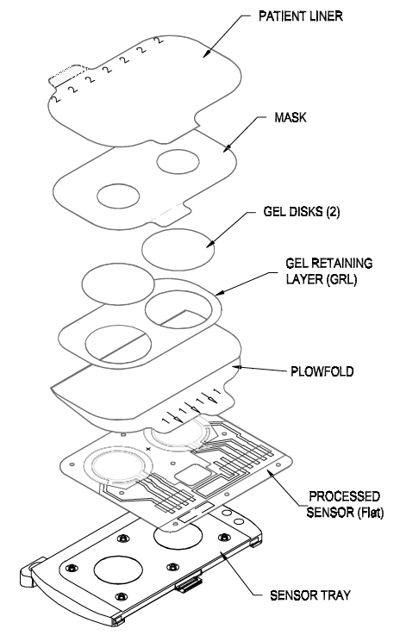
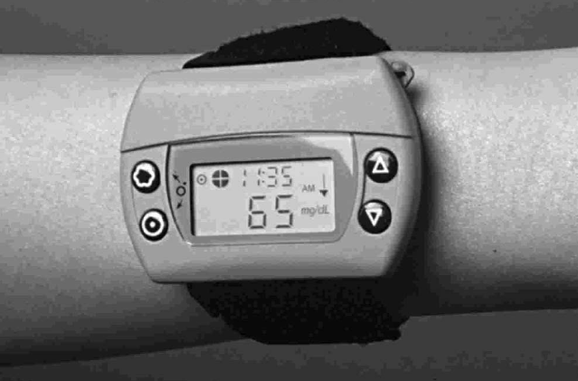
3 Method - Structure
1. crystal display
2. electronics circuits
- amperometric biosensor
- iontophoresis
3. microprocessor
4. data memory & serial port
5. temperature & skin conductivity sensor
6. disposable AutoSensor
- biosensor
- iontophoresis electrodes
- hydrogel discs

Slide 6
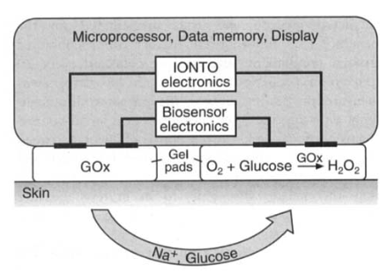
Principle
Working procedure:
1. glucose sample extraction via reverse iontophoresis
2. glucose measurement by amperometic sensor
3. data processing to display
Figure 1. Schematic design of the GlucoWatch biographer

Slide 7

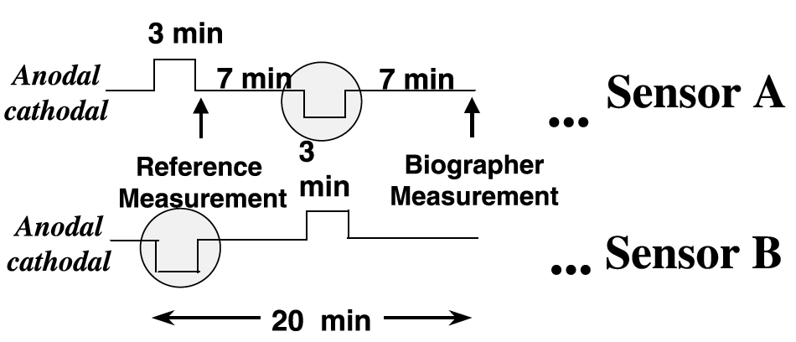
Principle (continue)
Step 1
skin
electro-omostic flow
blood vessel
Na⁺
Average flux: 1 nmol/cm²/L
glucose
electric current
Figure 2 Reverse iontophoresis to extract glucose
Step 2
Step 3
Figure 3 iontophoresis and biosensor duty cycle

Slide 8
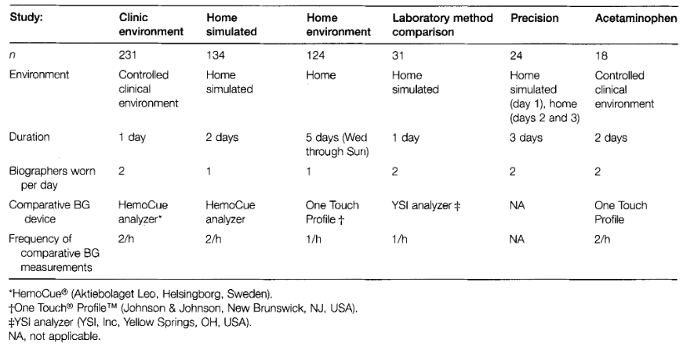
4. Experiment Results
Statistics of trial subjects:
1. gender: # of male ≈ # of female
2. age: 48
3. duration of diabetes: 17 years
4. ethnicity: 75% Caucasian, 10% Africa American, 15% others
Table 1 summary of 6 clinical trials for evaluating the performance of GlucoWatch

Slide 9
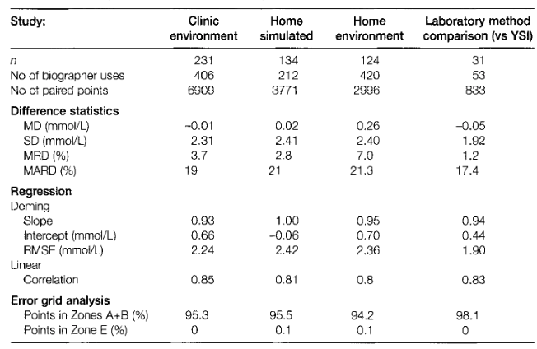
GlucoWatch could measure glucose accurately
MD: mean differance
SD: standard deviation
MRD: mean of relative difference
MARD: mean of absolute value of relative difference
RMSE: root mean squared error
Table 2 Accuracy measure of 4 trial studies

Slide 10
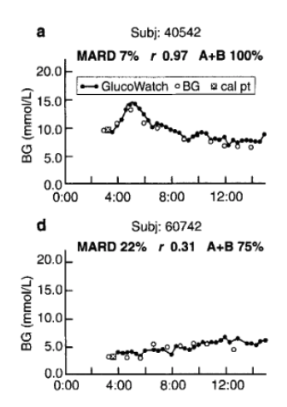
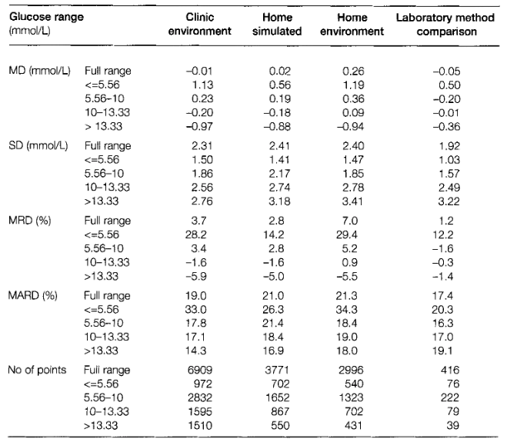
Factors that affect measurement accuracy
Factor 1. blood glucose range
Table 3 Effect of blood glucose range on GlucoWatch accuracy

Slide 11
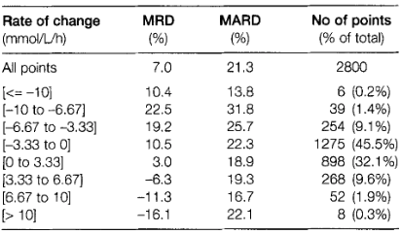
Factors that affect GlucoWatch accuracy(continue)
Factor 2. change rate of blood glucose level
Table 4 Effect of rate of change of blood glucose on GlucoWatch accuracy
Factor 3. Ethnicity
African-Americans have negative values for MD
Factor 4. Body mass index

Slide 12
5. Conclusion
Clinical trials show GlucoWatch biographer are accurate and precise compared to serial fingerstick glucose measurement over a 12-h period.
This noninvasive method extends the glucose measurement time range and provides accurate glycaemic alert.
Efficient data enables analysis of trend and pattern of glucose levels for better and personalized glycaemic control regimen.

Slide 13
Critique
Higher Hyperglycarmic and Hypoglycaemic alert accuracy (75% and 79%, respectively) are required for practical use.
Biosafety is a big problem (0.8% strong skin irritation).
Practically poor performance, relatively complex operation, and imcompability with existing monitoring standard lead its failure.
Thinking:
It's easier to get uncharged molecules into the skin than out of it.
Trying to force glucose across the intact skin may alter the local concentration of glucose.
Notes:
75% with 10% false alerts
79% of hyperglycaemic points (BG > 17 mmol/L) with 8% false alerts.

Slide 14
Reference
Tierney MJ, Tamada JA, Potts RO, Eastman RC, Pitzer K, Ackerman NR, Fermi SJ. The GlucoWatch biographer: a frequent automatic and noninvasive glucose monitor. Ann Med. 2000 Dec;32(9):632-41. doi: 10.3109/07853890009002034. PMID: 11209971.
Smith, John. (2006). The Pursuit of Noninvasive Glucose: Hunting the Deceitful Turkey.
So, Chi-Fuk et al. “Recent advances in noninvasive glucose monitoring.” Medical devices (Auckland, N.Z.) vol. 5 (2012): 45-52. doi:10.2147/MDER.S28134
Wikepedia - Cygnus Inc
Wikipedia - Noninvasive glucose monitor

